Slide 1





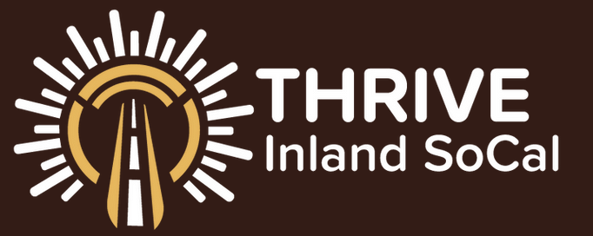
Clean Economy Adoption (Quality Job Creation)
Strategies and tactics
Warehouse rooftop community solar: Community solar installations on warehouse roofs can begin to compensate for environmental harms caused by these facilities by expanding lower-income households’ access to low-cost clean energy, reducing GHG emissions, and creating new quality jobs that are accessible to struggling workers in the community—all at no cost to residents and without need for public-sector funding. This effort will require collaboration among community solar developers, community-based organizations, community members, building owners, and workforce development providers.
Clean Economy Business Initiative: Help local small businesses benefit from the energy transition by identifying how they can contribute to the clean economy and connecting them with new customers and the support services they need to succeed.
Small Business Climate Transition Network: Establish an easy-to-navigate climate transition support network to help local small businesses access the assistance they need. By leveraging existing programs and expanding regional outreach, climate transition planning, technical assistance delivery, and other critical functions, Inland SoCal can ease the path for smaller companies during this disruptive period.
Clean Logistics Consortium: Convene a consortium of companies, ports, railroads, utilities, regulators, and public-sector actors to co-design a path to wholesale logistics decarbonization in the region and implement the investments and actions needed to accomplish this unparalleled task.
Why is this topic important?
The clean economy aims to address the effects of climate change, boost climate resilience, and accelerate the transition to clean energy. It includes a wide range of industries, products, and services that touch almost every aspect of daily life.
Supercharging regional adoption of clean economy solutions will accelerate the energy transition, strengthen local businesses, and improve quality of life for Inland SoCal residents, with emphasis on communities hardest hit by climate impacts and industrial pollution. It will also give Inland SoCal an advantage over other regions that underinvest in this sector, particularly as the pace of the energy transition increases.
Adoption of clean economy solutions can have an outsized impact on struggling families’ financial self-sufficiency, health outcomes, and overall quality of life, but only if they are involved in this transition. Community-based organizations will play a role in ensuring that community members’ priorities and the distinctive histories and cultural knowledge within these communities are take into account.
What we have heard from the community…
Key data findings…
“. . . highlight the air quality issue affecting our region as we have consistently ranked among the worst in the nation according to the American Lung Association.”
Inland SoCal “. . . struggles with extreme heat, and we will need a local workforce to meet our cooling needs with upgraded air conditioners. These are important jobs as part of the clean economy and are usually small business owners.”
“Small businesses that do energy-efficiency work should also be included, such as . . . electricians and plumbers. There's a lot of funding from the state and feds to decarbonize and electrify. We will need more energy efficiency professionals who can install the equipment needed to reduce GHG emissions and/or energy demand on the grid.”
Over the next 30 years, Inland SoCal is expected to have hotter weather and longer heatwaves. Climate-related heat events intensify poor air quality in the region and increase risk of overheating and heat stroke, with serious implications for people’s health.
California has one of the most ambitious climate mandates in the nation. Achieving carbon neutrality by 2045 will require growing the clean economy fast enough and large enough to meet rising demand.
Many clean economy occupations—including solar installers, EV technicians, HVAC professionals, and energy auditors—require less than one year of training and offer opportunities for career advancement.
Rooftop community solar puts unused square footage to work by installing solar panels on the roofs of houses, apartment buildings, commercial spaces, warehouses, and factories.

